Slide 1
Genome Annotation
Day 2
Notes:
Anyone done this before?
Anyone going to do this? – Oksana did assembly
Detect functional elements in the genome

Slide 2
Goals of Annotation
Find transposable elements
Find protein coding genes
Exons
Start/Stop/Splice sites
Introns
Find regulatory elements
Notes:
What functional elements? The way that you annotate depends on what you want to do with the data.
Tandem array elements
Interspersed repeats
UTRs

Slide 3

Find non coding RNA elements
Name and classify results
Putative gene name
Functional identification
Pathway identification
EST annotation

Slide 4
The first step…

Slide 5
Repeat Masking
Speeds up gene predictions
BUT…
Tandem array elements can be part of genes
THEREFORE…
Mask only Interspersed repeats (i.e. TEs)
Notes:
People also might be interested in the repeats!
There are other ways to investigate repeats…

Slide 6
The next step…

Slide 7

Prediction Methods
Homology based (map to genome)
Known proteins (or repeats)
ESTs
Pattern matching
Exonerate
EST2Genome
GeneWise
GeneMapper
BLAST
RepeatMasker
Notes:
Normally – specify the degree of matching
Well characterised genome – high homology

Slide 8

Prediction Methods
De novo
Prediction models
Conserved regions
ORFs
Commonly Markov models
Augustus
GeneMark
Eugene
GlimmerHMM
LTRharvest
Notes:
Hexamer frequency
NC elements can be predicted using different programs – we will not do it here (although some might be predicted)
Conserved transposable elements can also be predicted

Slide 9
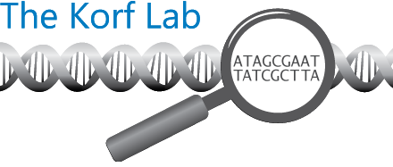
Training Data
Well annotated genes mapped to the genome
Homologous genes
Experimentally verified
Manually Annotated
Unfortunately…
Novel genomes do not come with training data
CEGMA?
Notes:
Conserved elements – start stop codons, splice sites

Slide 10
The final step…

Slide 11
Genome
Repeat Masking
Tandem Arrays
Interspersed repeats
Homologous Predictions
ESTs
De novo Predictions
Known Proteins
Training Data
Prediction

Slide 12
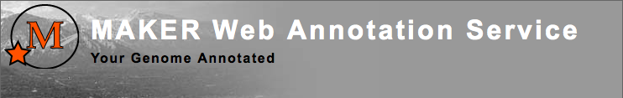
Automated Annotation
Programs that combine various sources of information
MAKER (MWAS)
CEGMA

Slide 13
But first;
choose your scaffolds to annotate
Notes:
Because of time for us
Some people don’t want to annotate everything

Slide 14
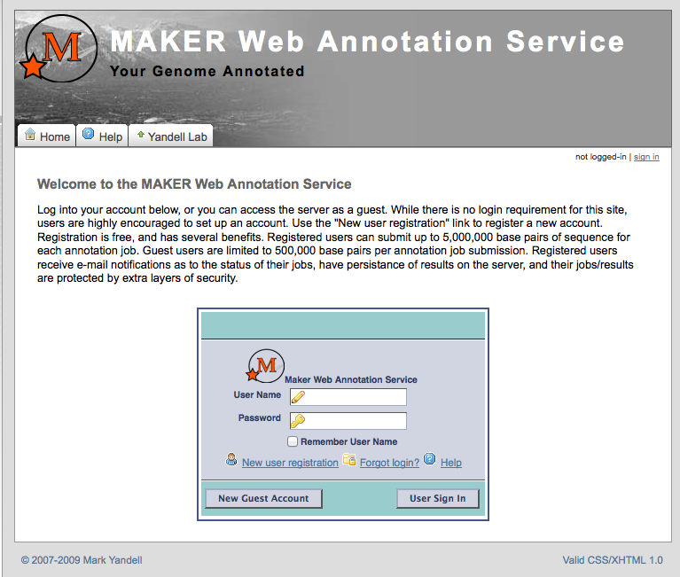

Slide 16
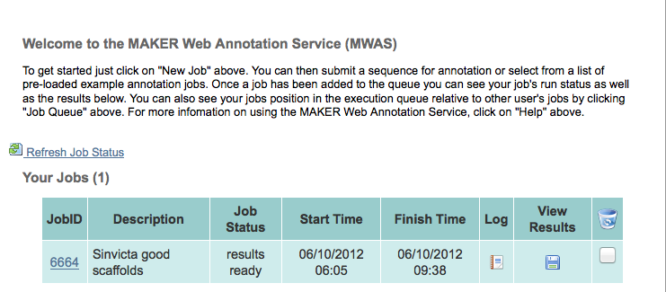

Slide 17
Good Points
Fast
Bad Points
Discover novel genes
Allows for bulk annotation
Low accuracy
Perpetuates errors
Don’t always know exactly what has been done
Notes:
Of automated annotation.

Slide 18
Only proteins recognizable as proteins
Predictions are frequently biased towards shorter proteins
Short exons/genes can be missed
Multiple sources of predictions are needed for some genes, others are better with fewer sources
Protein coding genes only
Some programs are designed for sensitivity and some specificity
The bias towards fragmented genes or chimeric genes depends on the software
Notes:
Biases in genes

Slide 19
Manual Annotation
Visualization and editing tools
Apollo
Integrative Genomics Viewer
Genome Browser

Slide 20
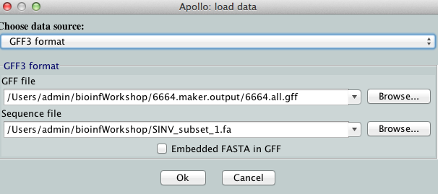

Slide 21
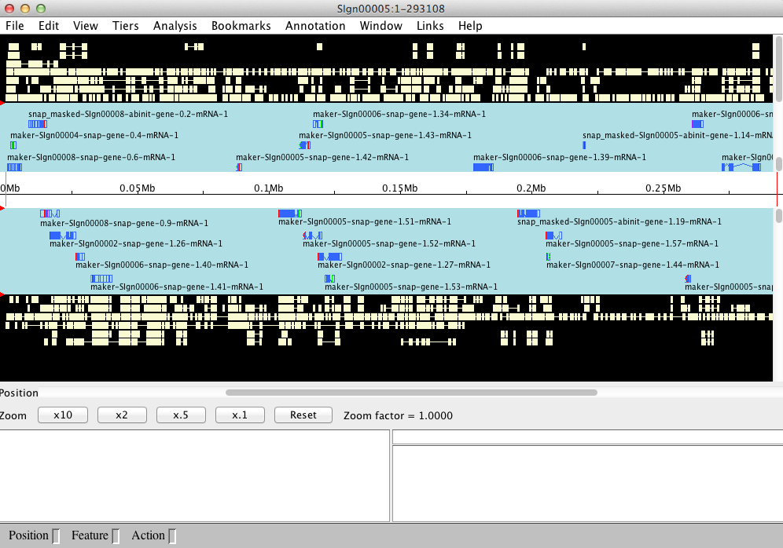

Slide 22
Good Points
Accurate
Bad Points
Know exactly what has been done
Can’t work in bulk
Very Slow
Human bias

